Slide 1
Are you thinking what I’m thinking?
Perspective-taking in a language game
Notes:
Investigated how people use perspective-taking when designing and interpreting utterances – how speakers choose what to say based on how it is likely to be received and how hearers interpret this based on the likely intention. Here’s what I’ll do:
1. Intuitions about why this might not be so straightforward.
2. Some theories. Light.
3. Some empirical stuff. Light.
4. Motivation for my study and how it operationalises things.
5. Experiment 1.
6. Experiment 2.
7. Interpretation.
9. Outstanding questions. Ideas from you?

Slide 2
Language is ambiguous
‘Where is the post office?’
’At least you’re not complaining about it’
‘He’s a bastard’
Notes:
We are extremely good at using language to do things together, despite the ambiguity often involved in utterances and interpretations.
How do we figure out what people mean and decide how best to express ourselves? It looks very easy and fluid but a bit of scrutiny reveals a lot of complexity.
Examples.
It is not necessarily the case that speakers and hearers need to simulate their interlocutors’ mental states in order to tailor communication – they could also do it by relying on assumptions of shared context, shared world knowledge, shared linguistic knowledge, or previous interaction history.
Perspective-taking is arguably most important when PERSPECTIVES DIFFER. E.g. ‘he won’t know what I mean if I use this word or this phrase so I have to reformulate’ or ‘she can’t mean that literally so she must be speaking ironically or metaphorically’.This asymmetry will be important later.
So anyway, how do we do it?

Slide 3
So how do we do it?
Controversial!
One extreme: Mainly through interaction and alignment, only using mental models to repair.
Another extreme: Mainly through simulating other people’s mental states.
Not only theoretical reasons to be confused, also empirical reasons...
Notes:
At one extreme: through interaction, we align (lexical, semantic, syntactic priming) and then because we remember what we’ve been through together, we can just assume aligned perspectives. We just say whatever has worked in the past and repair explicitly (‘what do you mean?’) when communication fails. Dubious because: we clearly can and do sometimes spontaneously take perspective before the need to repair. If I can see something that you can’t, I will not simply ask you to give it to me.
At the other extreme: we simulate, update, and maintain models of other people’s world views in order to know what they mean and know how we should design utterances to be understandable. Dubious because: cognitively implausible.

Slide 4
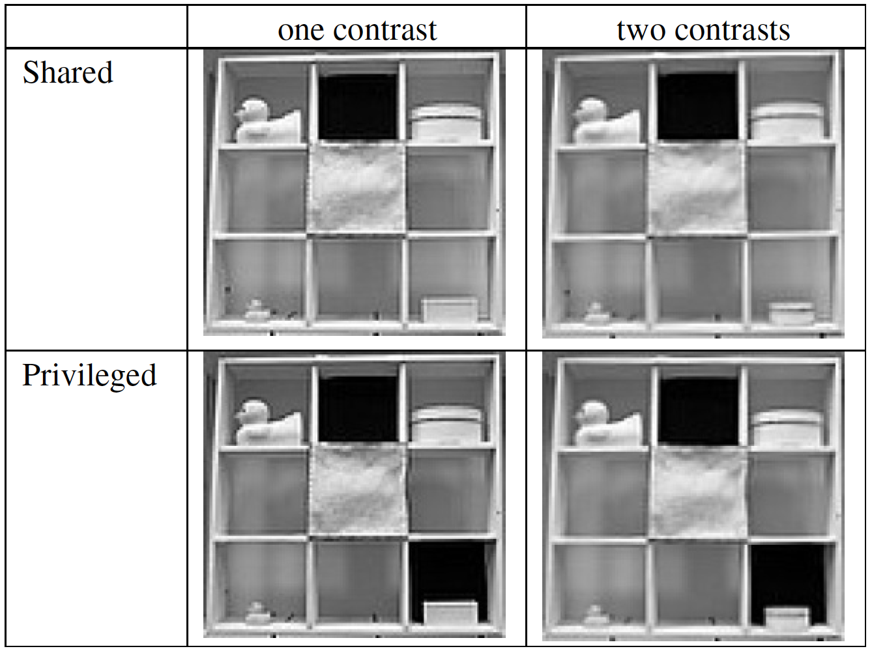
Previous studies
Visual world eye-tracking,
collaboration games, etc.
Some show ability to take
perspective, some show
surprising egocentricity.
Some methodological issues.
‘Pick up the big duck’
Notes:
For example: if you tell me to pick up a box and I can actually see six boxes but you can only see one, I should be able to use my knowledge of your perspective to infer that you can only mean the box you can see and not one of the others. Vice versa, if I want you to pick up a box and I know you can see several, I have to provide more information than ‘pick up the box’ – like ‘pick up the big box’.
Methodological issues:
In many of the studies that found perspective-taking, the perspectives did not actually differ for the speaker and the hearer. It is important to investigate situations where perspectives are asymmetric (so that if I try to just assume that what is salient and accessible to me is also salient and accessible to you, we will fail to communicate successfully).
Visual world things are not hard enough. You can just infer the other’s perspective straight from the scene in front of you and don’t have to use mental representations.

Slide 5
My study
A word guessing game!
Control the common ground better than in visual world paradigm.
No repeated “topics of conversation” – every trial is a new problem.
Restrict other ways of succeeding.
Compare symmetric and asymmetric situations.
Only success on asymmetric trials is actually evidence of perspective-taking.
Notes:
Explain in broad terms what the experiment was about

Slide 6
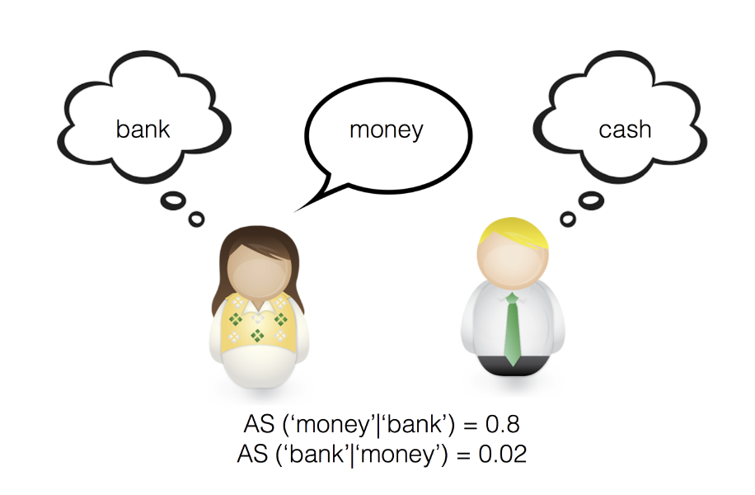
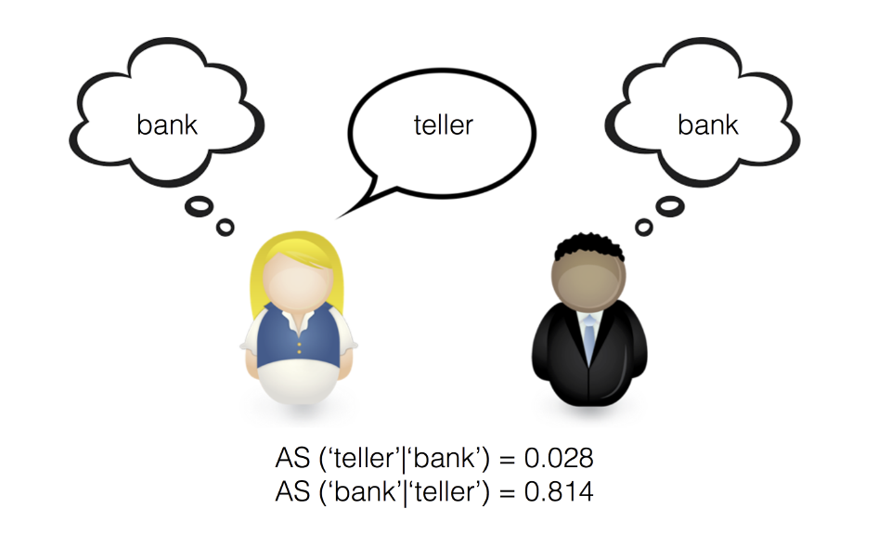
Important concepts & operationalising
Symmetry
Egocentric and allocentric salience
Notes:
Symmetry. SWOW database.
For example, most people say ‘night’ when cued with ‘day’, and most people also say ‘day’ when cued with ‘night’. In this type of trial, the director could succeed by just providing her own first association as a clue word. An example of an asymmetric trial would be with the target word ‘dolphin’; in response to ‘dolphin’, most people say ‘mammal’ but in response to ‘mammal’, most people do not say ‘dolphin’ – they say ‘animal’. Only success on asymmetric trials would be proof of perspective-taking.
Egocentric and allocentric salience.
The backward association strength between the target ‘plague’ and the clue ‘rat’ is 0.01 whereas the backward association strength between the target ‘plague’ and the clue ‘bubonic’ is 0.38. This means that giving ‘bubonic’ as a clue is more likely than ‘rat’ to elicit the correct response ‘plague’. If the speaker chooses ‘bubonic’ over ‘rat’, she is taking perspective. If her clue had been driven by forward association strength, she would have given ‘death’, the highest ranked forward associate of ‘plague’ (strength = 0.13). If the director did give ‘rat’ as a clue, the matcher would be showing perspective-taking if he did not say ‘mouse’ – the highest forward associate of ‘rat’ (strength = 0.13) – but instead ‘rodent’, a target word more likely to have elicited the clue word ‘rat’ (strength = 0.27).

Slide 7
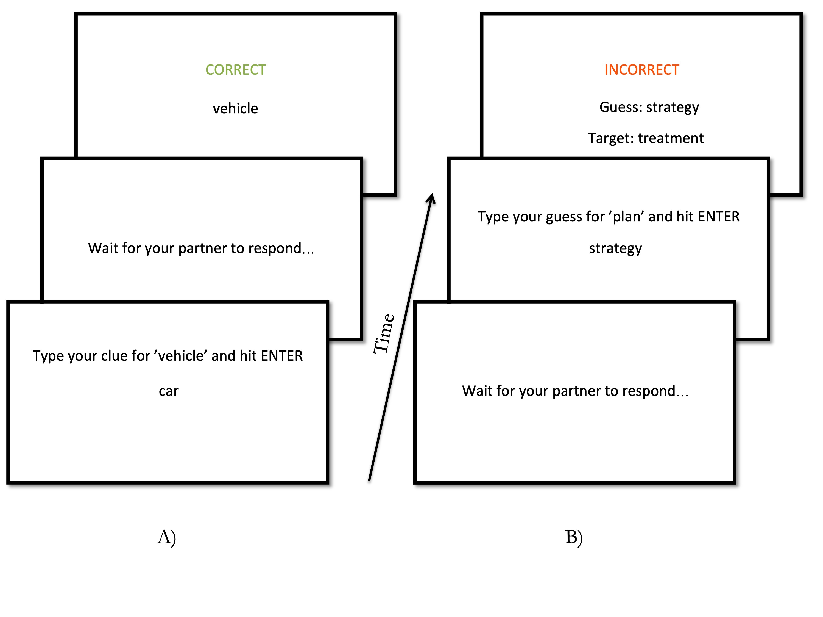
Experiment 1: Setup
Half the targets were symmetric and half asymmetric
As much time as they wanted
120 target words (approx. one hour)
Feedback
Main measures:
1. Success
2. Backward association strength
Notes:
If two people play a perspective-taking game together for an hour, they must tune into each other’s semantic networks and realise that they can’t just say the first thing that pops into their own head. Right?

Slide 8
Let’s try it out!
What would be a good clue for…
Department?
Sense?
Dog?
Egg?
Office?
Notes:
If two people play a perspective-taking game together for an hour, they must tune into each other’s semantic networks and realise that they can’t just say the first thing that pops into their own head. Right?

Slide 9
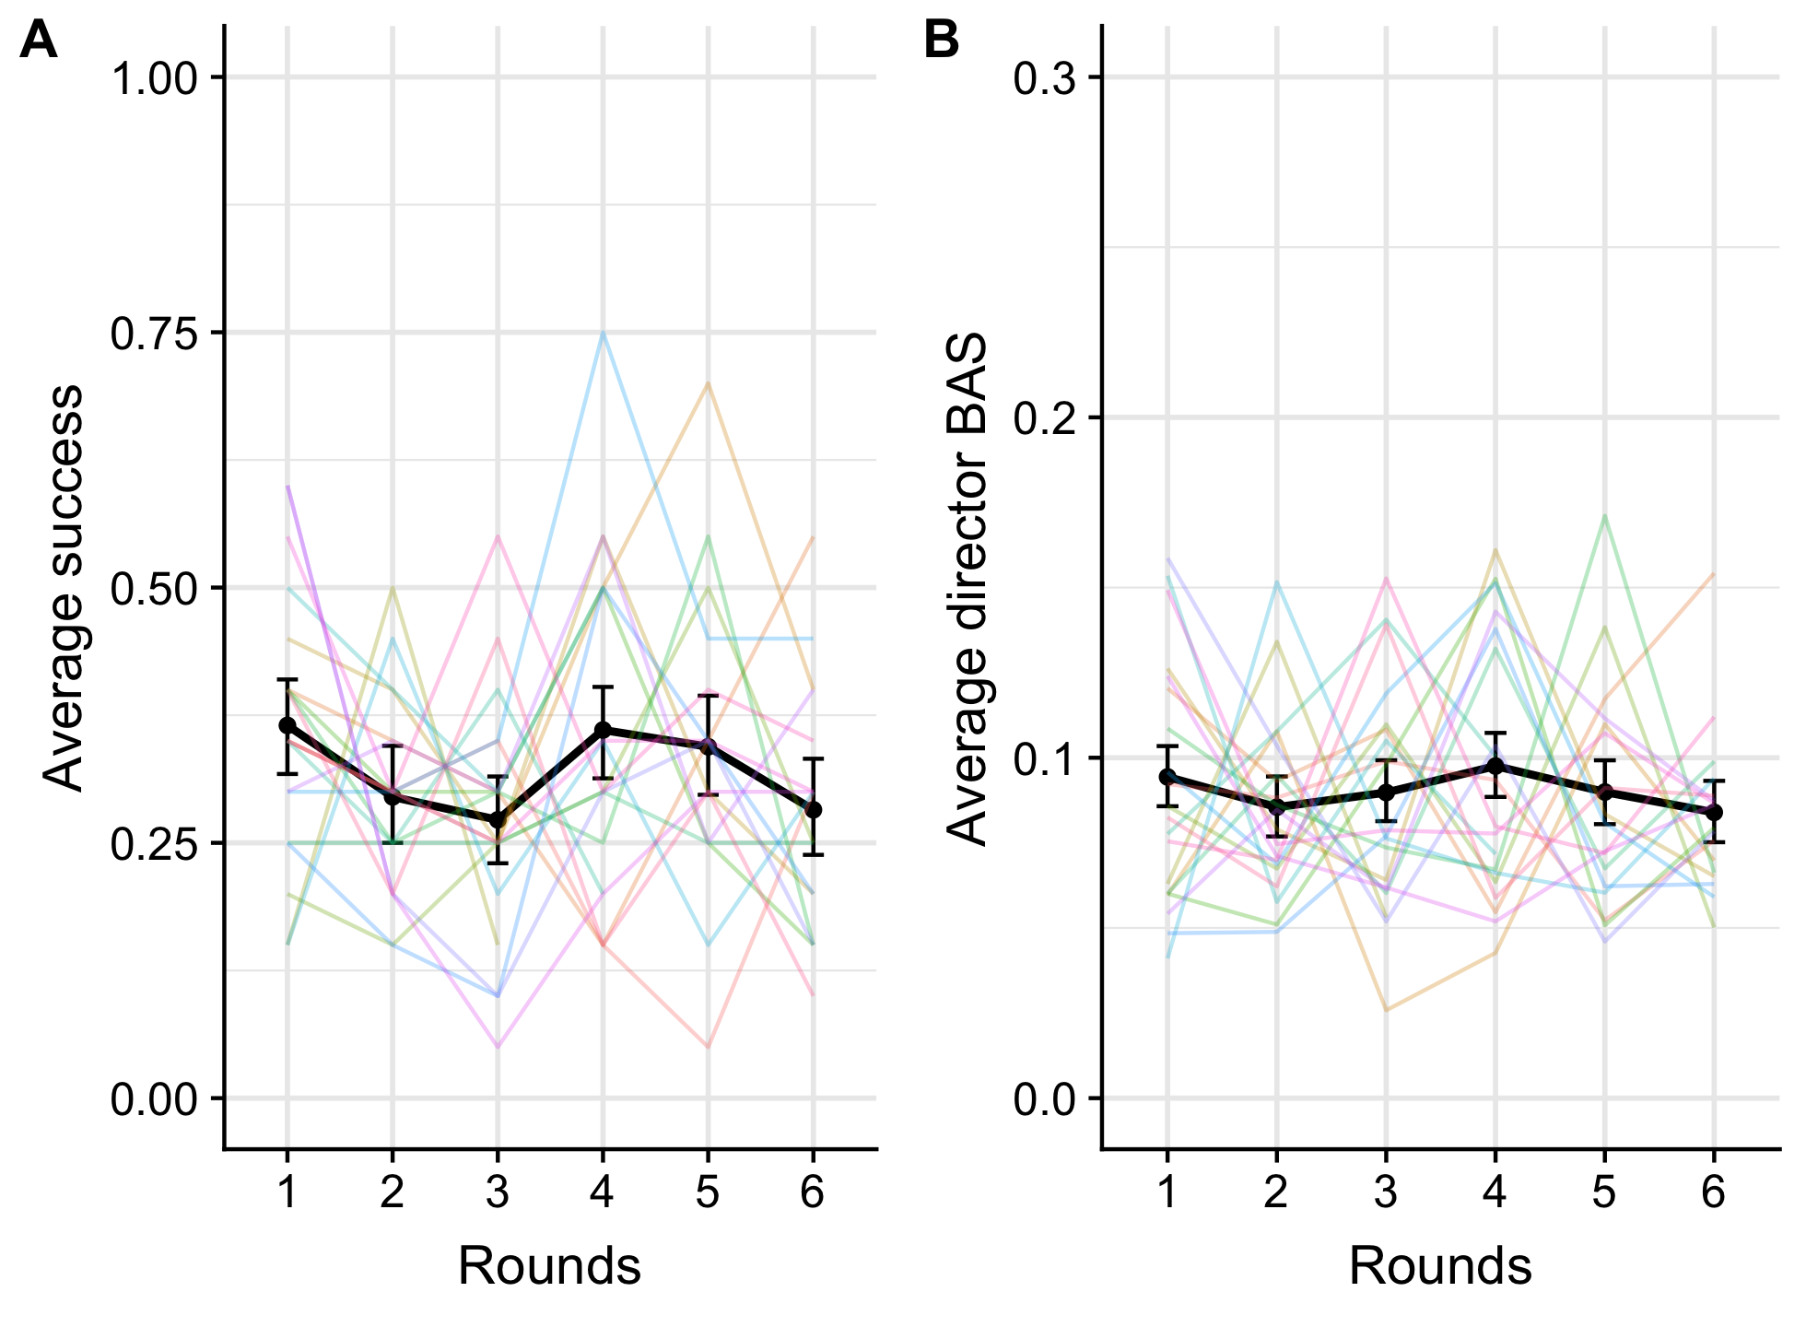
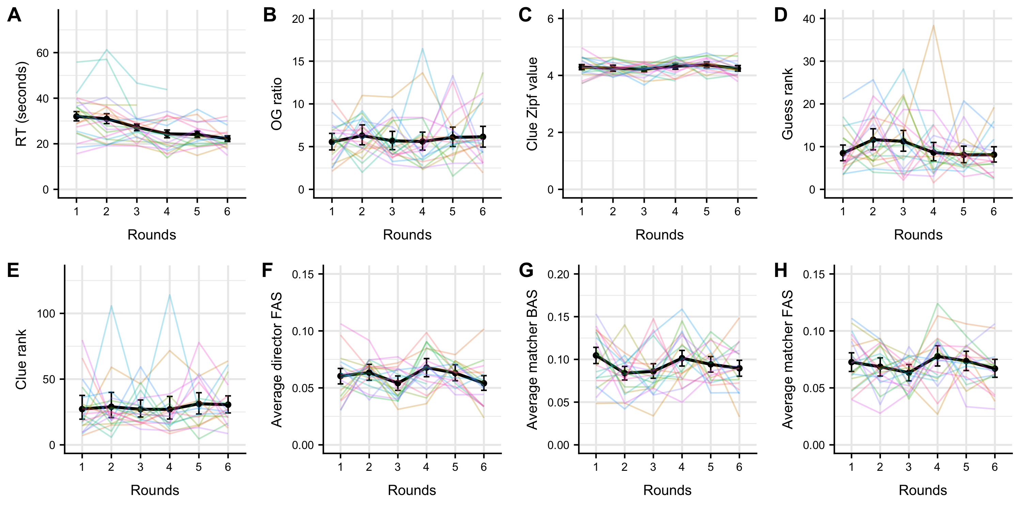
Experiment 1: Results
Impressive (target – clue – guess) | Not impressive (target – clue – guess)
Cave – spelunking – cave | Cave – bat – man
Heart – cardiovascular – heart | Heart – love – hate
Door – handle – door | Door – arch – nemesis
Pig – oink – pig | Pig – latin – classics
Director – producer – director | Director – Spielberg – Steven
Pizza – Italian – pizza | Pizza – margherita – cocktail
Color – purple – color | Color – rainbow – lgbtq
Notes:
Go through the examples and why they are good or bad
The only thing that happened was that they got faster. Also, symmetric items were easier than asymmetric items, indicating that they found perspective-taking hard. Sanity check.

Slide 10
Why this?
I was surprised!
Maybe they can’t learn to take perspective.
Maybe they did rely on perspective-taking for the little success they had but the search for good clues was simply too cognitively demanding.
What if we try to help them as much as we can? → Experiment 2!

Slide 11
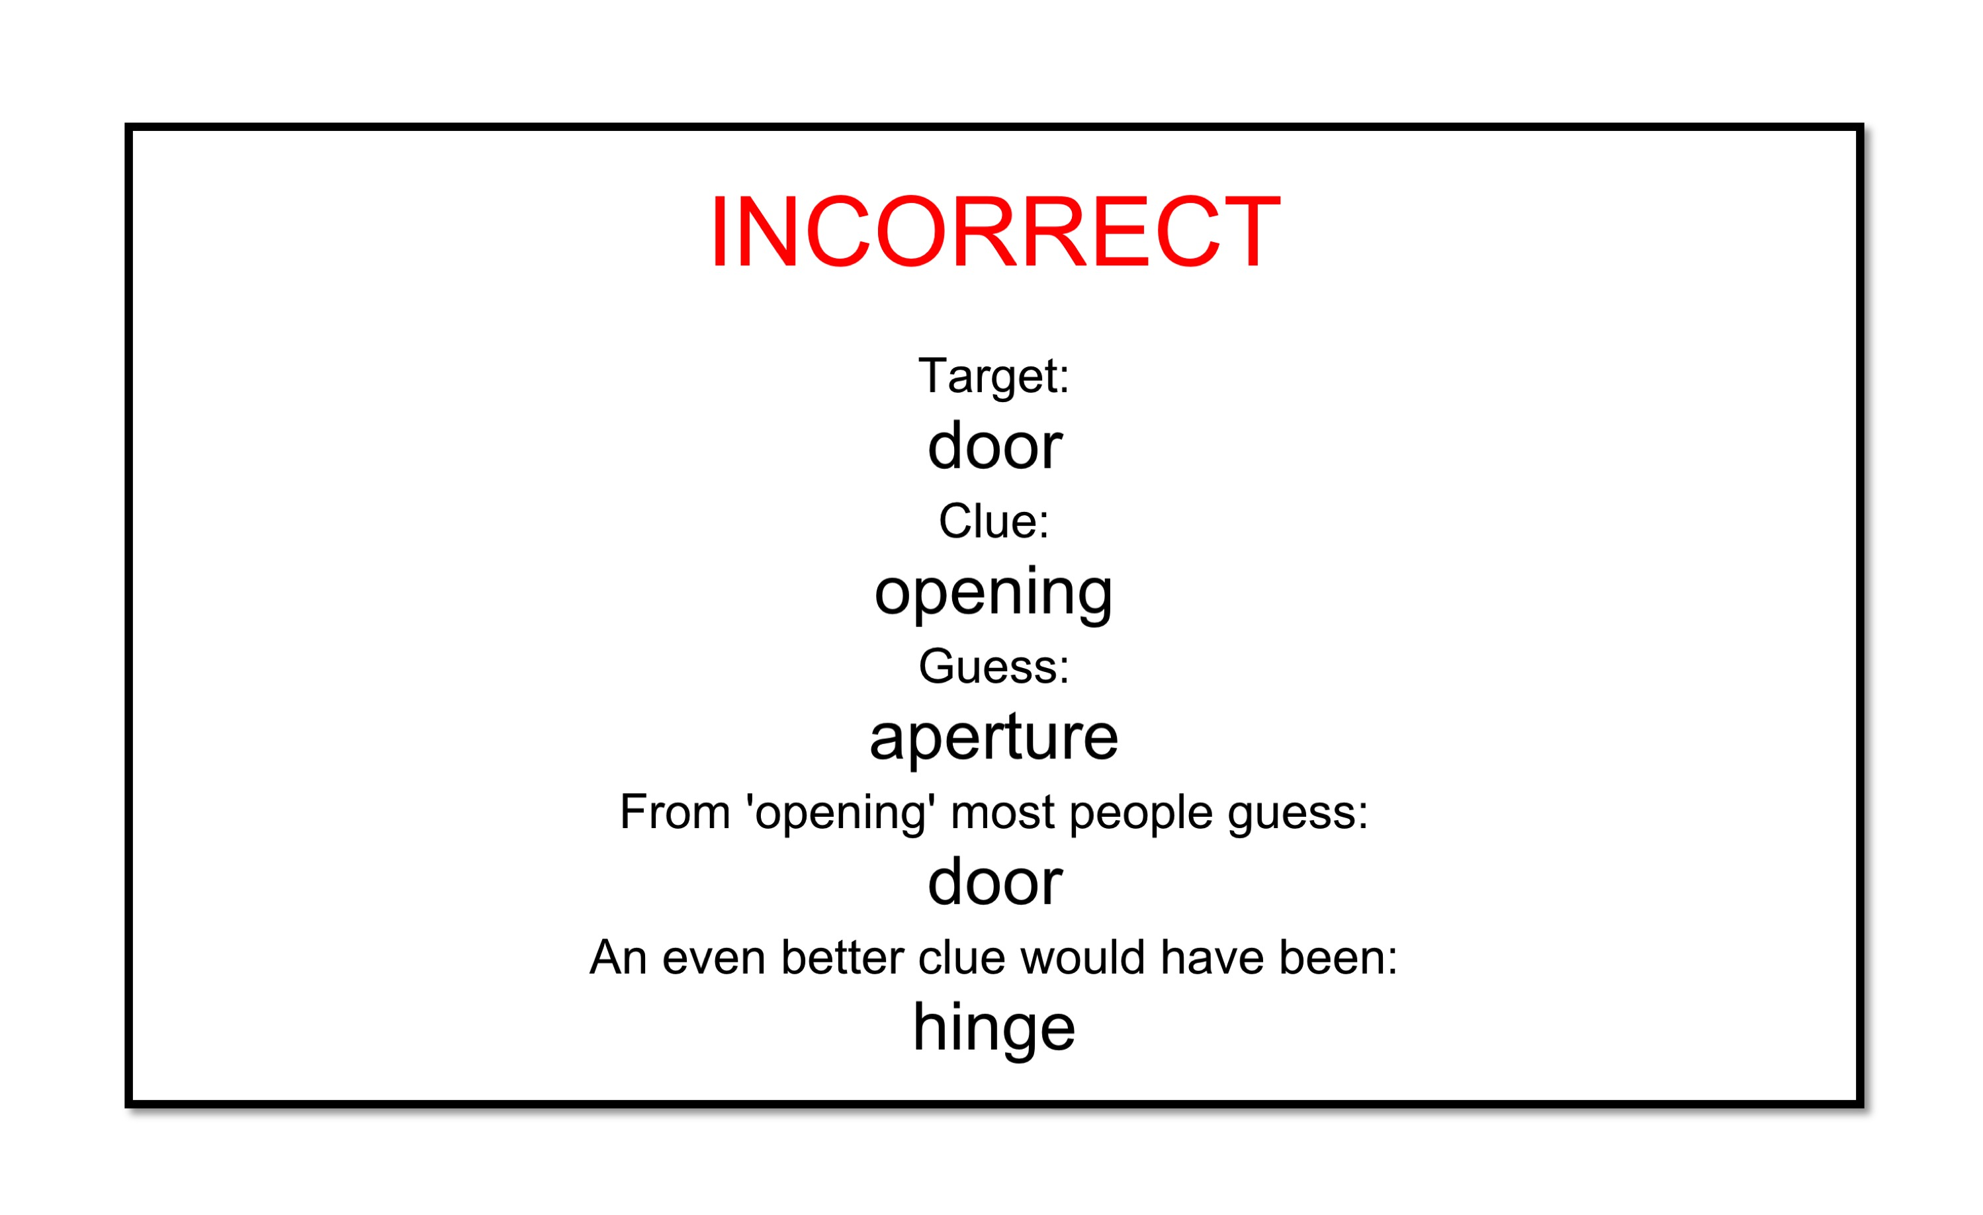
Experiment 2: Setup
Basically the same except we tried to go all out on the help.
Richer feedback and easier targets.
Notes:
What kind of feedback?
What does it mean for the target words to be “easier”?

Slide 12
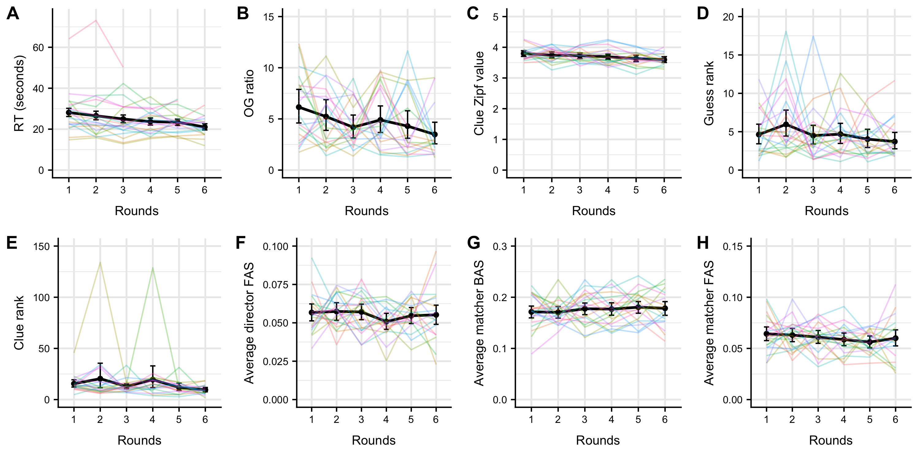
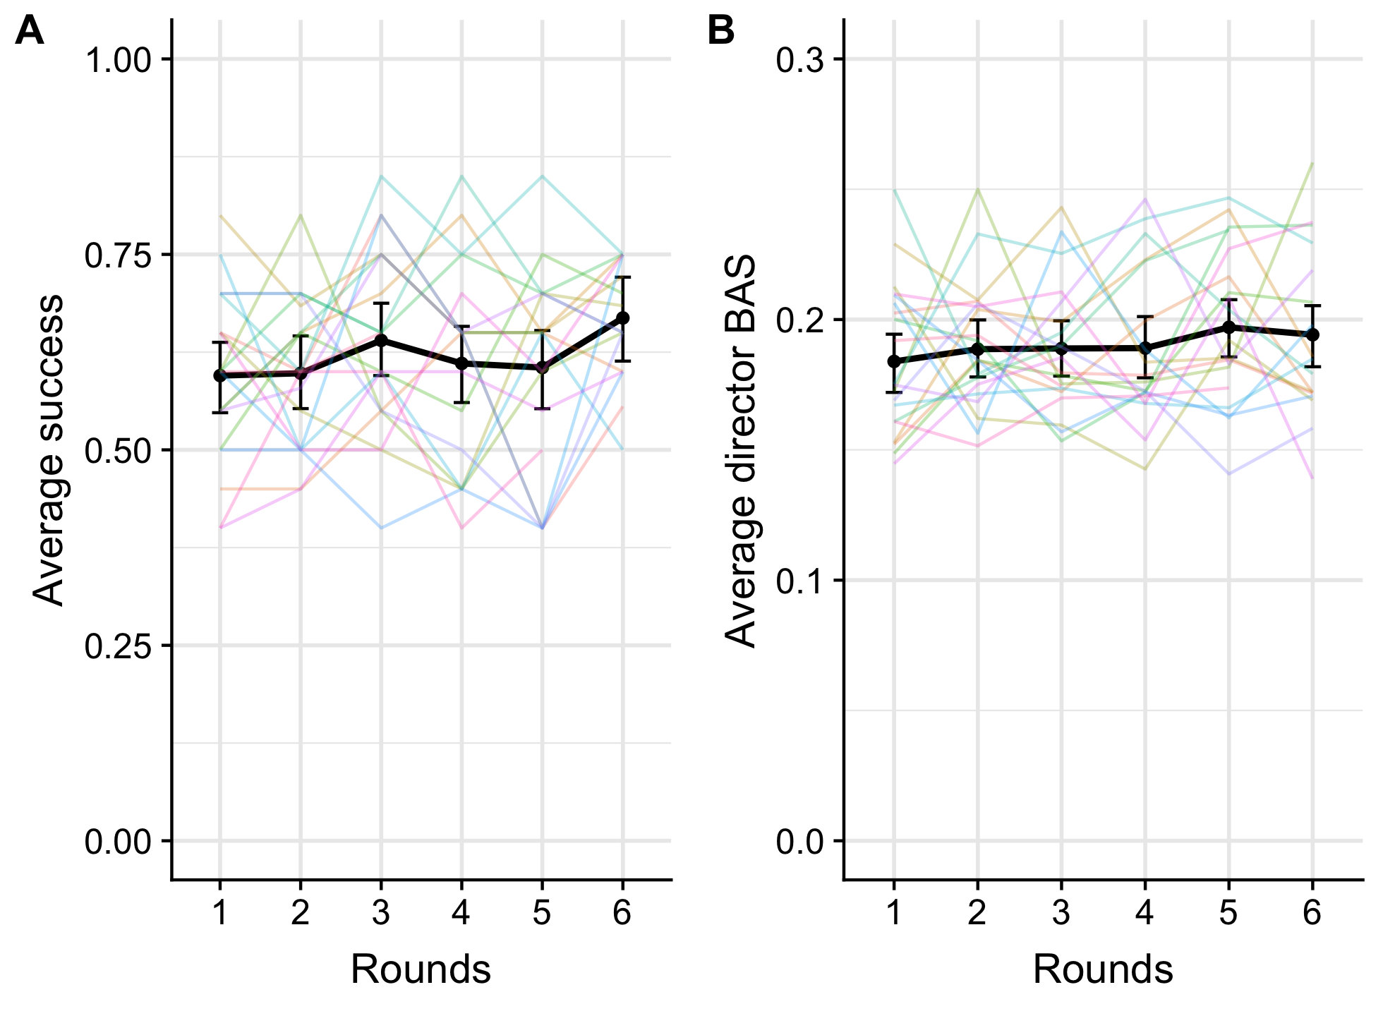
Experiment 2: Results
Notes:
A change! But it was tiny

Slide 13
Interpretation
Something seemed to make a difference in Experiment 2.
What and why?
Active perspective-taking is cognitively demanding and that the extent to which people can deploy it spontaneously in audience design is limited.
Notes:
Could be that easier target items made the strategy clearer.
Could be that increased feedback represented increased interaction.
Personally, I think they just learned to use rarer words and not perspective-taking. Supported by the stats: 1) when freq is included, round doesn't predict success. 2) freq is only predicted by round in exp 2, not in exp 1.
Regardless: Using perspective-taking spontaneously to overcome asymmetry is hard!
So does that answer the question of how we achieve successful communication in everyday life?

Slide 14
So how do we succeed in real life?
This was of course very constrained and controlled – in real life, we have both context and often interaction history to help us. I did this on purpose.
Recall the two theoretical positions?
It’s not obvious which one is supported.
In fact, two conclusions are possible.
Notes:
To sum up the relevant theoretical distinction, some positions claim perspective-taking is key in audience design (e.g. Sperber & Wilson, 1995; Clark, 1996) while others maintain we can communicate successfully by simply relying on automatic alignment of perspectives through interaction and context (e.g. Pickering & Garrod, 2004; Barr & Keysar, 2004). The main difference between these two types of accounts lies in to what extent people form, maintain, and manipulate mental models of other people’s mental states.
1) People do use perspective-taking in normal communication but it is just too demanding to deploy it in this setup (which is why we saw it improve somewhat in Experiment 2 which was designed to be helpful), or
2) People do not rely on perspective-taking in normal communication, and the reason we saw improvement in Experiment 2 was that participants had more opportunity to align through more elaborate feedback and more explicit indication of what it meant to give good clue words.
Previous literature suggests context-free perspective-taking is demanding and effortful (as do the reaction time results from the present study) which means the first conclusion seems more likely.

Slide 15
Outstanding questions
What exactly made the difference in Experiment 2? Just clue word frequency?
Can you actually strip away all context? Even here, they had still seen each other and they were also in a university setting in a British-American popular culture (they used this a fair bit). They also very eagerly used interaction history when they could.
Individual differences in perspective-taking? Why are some people better at this kind of game than others?

